Slide 1
Day 2
Notes:
NOTE: The green and purple slides are for information only, not to be shown in any videos

Slide 2
8:30-9:45 LUIS

Slide 3
Welcome Back!!
Day 1: Cognitive Services
8:30-9:15: Setup
9:15-10: Cognitive Services and PictureBot Introduction
10-12: Lab 1: Computer Vision
12-1: Lunch
1-1:30: Custom Vision Service Introduction
1:30-2: Lab 2: Custom Vision Service I: Image Classification
2-2:30: Lab 3: Custom Vision Service II: Object Detection
2:30-3:45: Lab 4: Azure Search
3:45-4:15: Bot Design and LUIS Design Overview
4:15-5: Day 1 Case: Part 1: Bots and Part 2: LUIS
5-6: Learn AI Office Hours
Day 2: Bots
8:30-9: Recap and Intro to LUIS
9-9:45: Lab 5: Language Understanding Intelligent Service (LUIS)
9:45-10:15: Bot Architectures
10:15-12: Lab 6: Building Intelligent Bots
12-1: Lunch
1-2: Lab 6 continued
2-4: Lab 7: Bing Search
4-5: Day 2 Case: Part 1: Bot Architectures and Part 2: Cognitive Services
5-6: Learn AI Office Hours
Day 3: Knowledge Mining/Final Case
8:30-9: Recap, Cognitive Search Intro, and Lab Architecture
9-10:30: Environment Creation and Lab 9: Cognitive Search I: Text Skills
10:30-12: Lab 10: Cognitive Search II: Image Skills
12-1: Lunch
1-1:15: Final Case: Introduction
1:15-3: Final Case: Working time
3-4: Final Case: Presentations
4-5: Airlift Q&A and Feedback

Slide 4
LUIS
Notes:
We will go quickly through these slides, as it should be mostly a review of yesterday

Slide 5
Why NLU?
Rise of conversation-based applications
Need to extract meaning from context
Problem
We are not all data scientists, but we all need to be able to integrate NLU into our applications
Background
Notes:
Understanding NLU Stanford presentation: https://nlp.stanford.edu/~wcmac/papers/20140716-UNLU.pdf
Wikipedia: https://en.wikipedia.org/wiki/Natural_language_understanding
Why chatbots won’t survive without NLU: https://chatbotsmagazine.com/why-chatbots-wont-survive-without-nlu-df3670e911c5

Slide 6
Microsoft's Language Understanding Intelligent Service (LUIS)
A machine learning-based service to build natural language understanding into apps, bots, and IoT devices
Quickly create enterprise-ready, custom models that continuously improve
Can configure with a rich UI or programmatically
Background
Notes:
LUIS whitepaper: https://www.microsoft.com/en-us/research/wp-content/uploads/2016/02/sigdial2015demo.pdf
https://www.luis.ai/

Slide 7
Developing LUIS Models
Intents
Utterances
Entities
Training and testing
Publishing
Features/Patterns
Active learning

Slide 8
Key LUIS concepts
Intents
Actions the user wants to perform
Utterances
Text input from a user your app needs to understand
Entities
Detailed information that is relevant to the utterance
Intent | Sample user utterance | Entities
BookFlight | “Book a flight to Seattle?” | Seattle
StoreHoursAndLocation | “When does your store open?” | open
ScheduleMeeting | “Schedule a meeting at 1PM with Bob in Distribution” | 1PM, Bob
Developing LUIS models
Notes:
1. https://docs.microsoft.com/en-us/azure/cognitive-services/luis/home

Slide 9
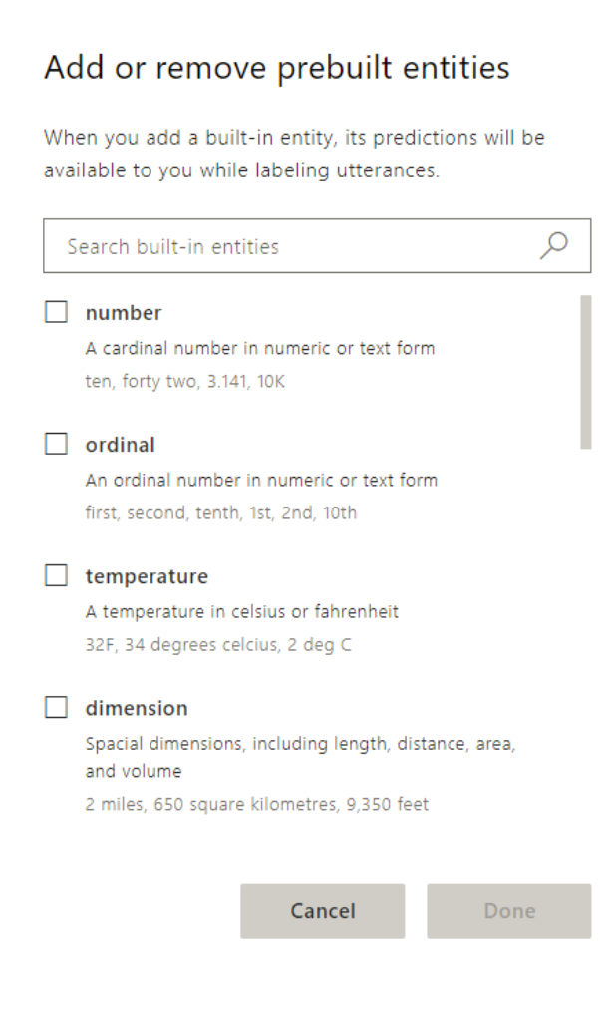
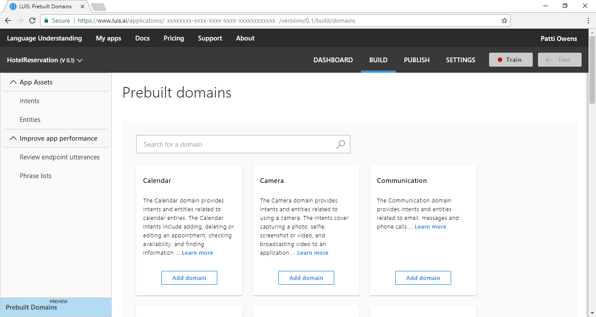
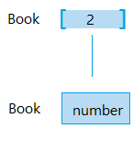
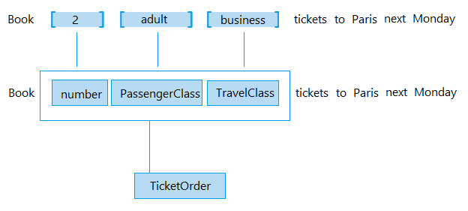
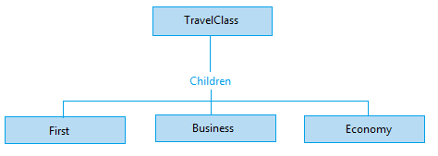
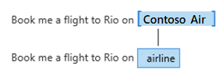
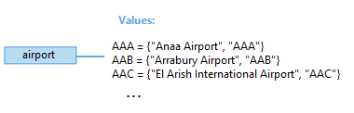
Key LUIS concepts
Simple entities
Hierarchical entities
Composite entities
Prebuilt entities
List entities
Developing LUIS models
Notes:
Plan your app: https://docs.microsoft.com/en-us/azure/cognitive-services/luis/plan-your-app
Prebuilt entity: https://docs.microsoft.com/en-us/azure/cognitive-services/luis/pre-builtentities
Prebuilt domains: https://docs.microsoft.com/en-us/azure/cognitive-services/luis/luis-how-to-use-prebuilt-domains
Best practices: https://docs.microsoft.com/en-us/azure/cognitive-services/luis/luis-concept-best-practices#entities
Recognizer-Texts, code behind prebuilt entities: https://blog.botframework.com/2018/01/24/contributing-luis-microsoft-recognizers-text-part-1/

Slide 10
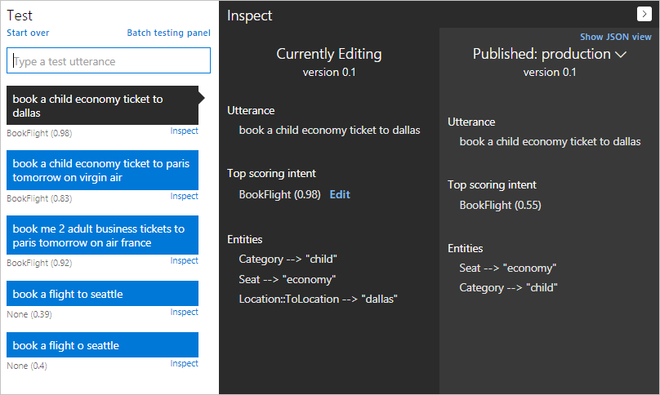
Training and testing your model
Developing LUIS models
Notes:
Train your model: https://docs.microsoft.com/en-us/azure/cognitive-services/luis/luis-how-to-train
Interactive testing: https://docs.microsoft.com/en-us/azure/cognitive-services/luis/train-test
Batch testing: https://docs.microsoft.com/en-us/azure/cognitive-services/luis/luis-how-to-batch-test

Slide 11
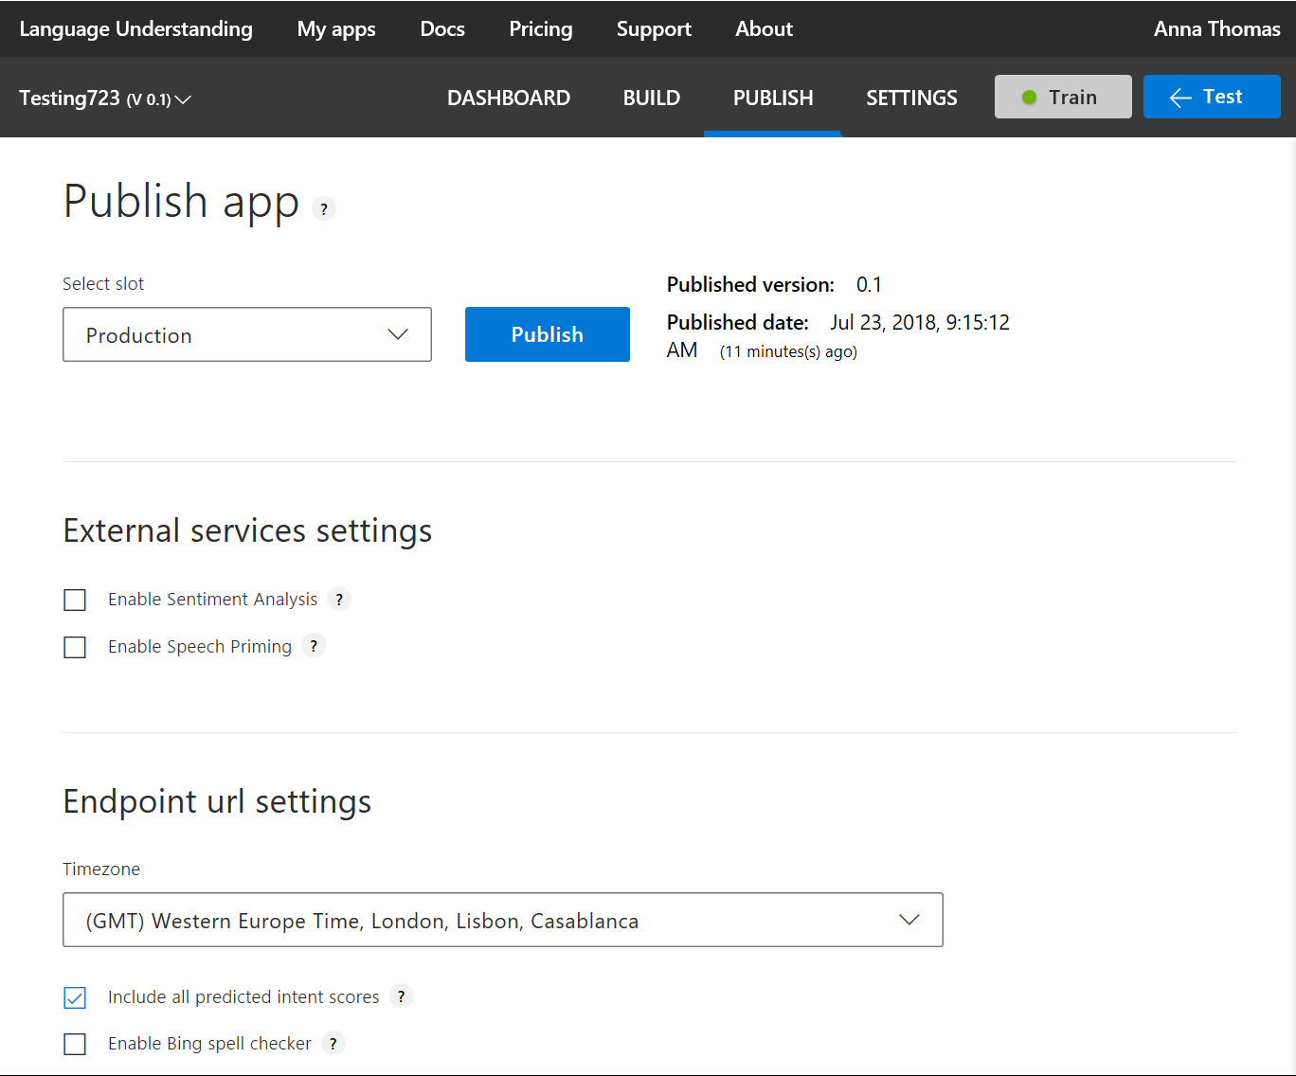
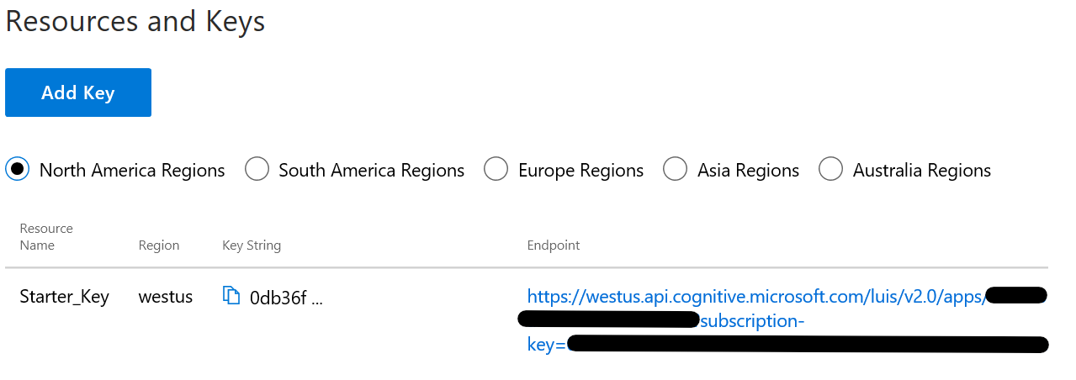
Publishing your model
Developing LUIS models
Notes:
1. Publish your model: https://docs.microsoft.com/en-us/azure/cognitive-services/luis/publishapp

Slide 12
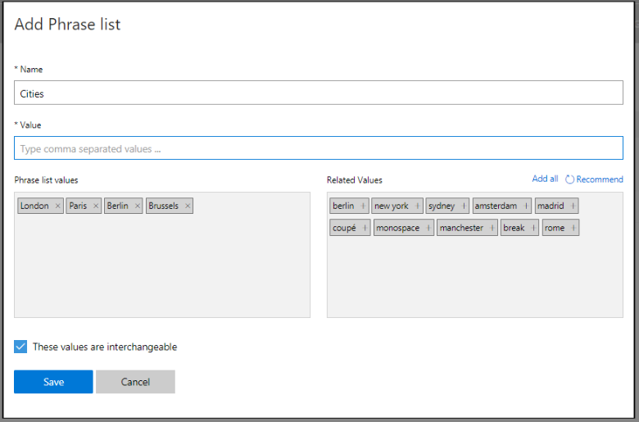
Adding features to improve performance
Features help LUIS by providing hints that certain words and phrases are part of a category
Developing LUIS models
Notes:
Add features: https://docs.microsoft.com/en-us/azure/cognitive-services/luis/add-features
10 phrase list must-haves blog: https://blogs.msdn.microsoft.com/benjaminperkins/2016/12/07/top-10-must-have-phrase-list-features-for-your-chatbot-or-any-bot-luis/

Slide 13
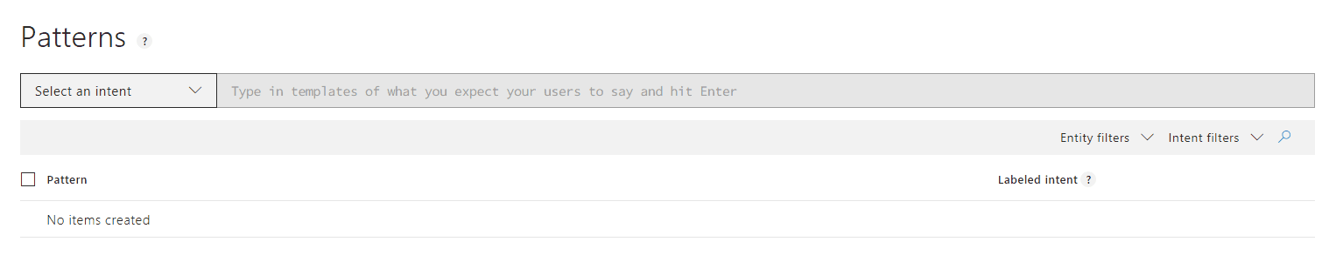
Adding patterns to improve performance
Patterns are template utterances with placeholders for entities used to further improve your model
Developing LUIS models
Notes:
Authoring cycle: https://docs.microsoft.com/en-us/azure/cognitive-services/luis/luis-concept-app-iteration
Label endpoint utterances: https://docs.microsoft.com/en-us/azure/cognitive-services/luis/label-suggested-utterances

Slide 14
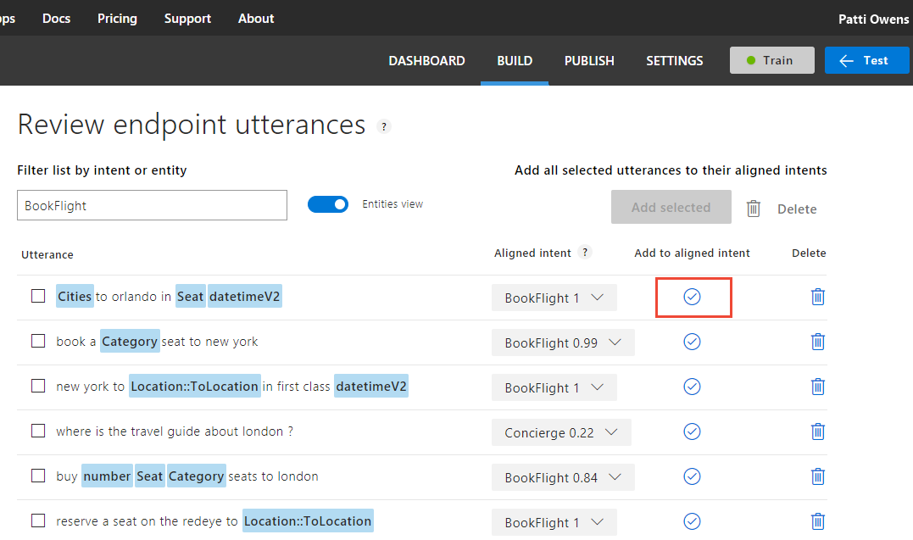
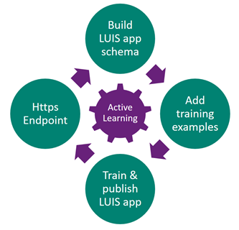
Using active learning
Developing LUIS models
Notes:
Authoring cycle: https://docs.microsoft.com/en-us/azure/cognitive-services/luis/luis-concept-app-iteration
Label endpoint utterances: https://docs.microsoft.com/en-us/azure/cognitive-services/luis/label-suggested-utterances

Slide 15
9-9:45AM https://github.com/Azure/LearnAI-Airlift and check out my blog if you finish early ☺ https://aka.ms/luis-notes
Lab 5: LUIS

